Slide 1
Chapter 11
Friends, Overloaded Operators,
and Arrays in Classes
Dai Liyun

Slide 2
Review Defining Classes（1）
Encapsulation
class
public
private
Constructor
Initialization Sections

Slide 3
Review Defining Classes（2）
class DayOfYear { public: void output( ); int month; int day; };
Member Function Declaration
void DayOfYear::output() { cout << “month = “ << month << “, day = “ << day << endl; }
Member Function Defining

Slide 4
Overview
11.1 Friend Functions
11.2 Overloading Operators
11.3 Arrays and Classes
11.4 Classes and Dynamic Arrays

Slide 5
11.1 Friend Functions

Slide 6
Friend Function
Class operations are typically implemented as member functions
Some operations are better implemented as ordinary (nonmember) functions

Slide 7
Program Example: An Equality Function
The DayOfYear class from Chapter 10 can be enhanced to include an equality function
An equality function tests two objects of type DayOfYear to see if their values represent the same date
Two dates are equal if they represent the same day and month

Slide 8
Class DayOfYear
class DayOfYear{
private:
int month, day;
public:
int get_month();
int get_day();
};

Slide 9
Declaration of The equality Function
We want the equality function to return a value of type bool that is true if the dates are the same
The equality function requires a parameter for each of the two dates to compare
The declaration is bool equal(DayOfYear date1, DayOfYear date2);
Notice that equal is not a member of the class DayOfYear

Slide 10
Defining Function equal
The function equal, is not a member function
It must use public accessor functions to obtain the day and month from a DayOfYear object
equal can be defined in this way: bool equal(DayOfYear date1, DayOfYear date2) { return ( date1.get_month( ) == date2.get_month( ) && date1.get_day( ) == date2.get_day( ) ); }

Slide 11
Using The Function equal
The equal function can be used to compare dates in this manner if ( equal( today, bach_birthday) ) cout << "It's Bach's birthday!";
A complete program using function equal is found in
Display 11.1 (1)
Display 11.1 (2)
Display 11.1 (3)

Slide 12
Is equal Efficient?
Function equal could be made more efficient
Equal uses member function calls to obtain the private data values
Direct access of the member variables would be more efficient (faster)

Slide 13
A More Efficient equal
As defined here, equal is more efficient, but not legal bool equal(DayOfYear date1, DayOfYear date2) { return (date1.month = = date2.month && date1.day = = date2.day ); }
The code is simpler and more efficient
Direct access of private member variables is not legal!

Slide 14
Friend Functions
Friend functions are not members of a class, but can access private member variables of the class
A friend function is declared using the keyword friend in the class definition
A friend function is not a member function
A friend function is an ordinary function
A friend function has extraordinary access to data members of the class
As a friend function, the more efficient version of equal is legal

Slide 15
Declaring A Friend
The function equal is declared a friend in the abbreviated class definition here class DayOfYear { public: friend bool equal(DayOfYear date1, DayOfYear date2); // The rest of the public members private: // the private members };

Slide 16
Using A Friend Function
A friend function is declared as a friend in the class definition
A friend function is defined as a nonmember function without using the "::" operator
A friend function is called without using the '.' operator
Display 11.2

Slide 17
Friend Declaration Syntax
The syntax for declaring friend function is class class_name { public: friend Declaration_for_Friend_Function_1 friend Declaration_for_Friend_Function_2 … Member_Function_Declarations private: Private_Member_Declarations };

Slide 18
Are Friends Needed?
Friend functions can be written as non-friend functions using the normal accessor and mutator functions that should be part of the class
The code of a friend function is simpler and it is more efficient

Slide 19
Choosing Friends
How do you know when a function should be a friend or a member function?
In general, use a member function if the task performed by the function involves only one object
In general, use a nonmember function if the task performed by the function involves more than one object
Choosing to make the nonmember function a friend is a decision of efficiency and personal taste

Slide 20
Test page 613, SELF-TEST EXERCISE 1
Write a function definition for a function called before that takes two arguments of the type DayOfYear, which is defined in Display 11.1. The function returns a bool value and returns true if the first argument represents a date that comes before the date represented by the second argument; otherwise, the function returns false. For example, January 5 comes before February 2.

Slide 21
Program Example: The Money Class (version 1)
Display 11.3 demonstrates a class called Money
U.S. currency is represented
Value is implemented as an integer representing the value as if converted to pennies
An integer allows exact representation of the value
Type long is used to allow larger values
Two friend functions, equal and add, are used
Display 11.3 (1 – 5)

Slide 22
Characters to Integers
Notice how function input (Display 11.3) processes the dollar values entered
First read the character that is a $ or a –
If it is the -, set the value of negative to true and read the $ sign which should be next
Next read the dollar amount as a long
Next read the decimal point and cents as three characters
digit_to_int is then used to convert the cents characters to integers

Slide 23
digit_to_int (optional)
digit_to_int is defined as int digit_to_int(char c) { return ( int ( c ) – int ( '0') ); }
A digit, such as '3' is parameter c
This is the character '3' not the number 3
The type cast int(c) returns the number that implements the character stored in c
The type cast int('0') returns the number that implements the character '0'

Slide 24
int( c) – int ('0')?
The numbers implementing the digits are in in order
int('0') + 1 is equivalent to int('1')
int('1') + 1 is equivalent to int('2')
If c is '0'
int( c ) - int('0') returns integer 0
If c is '1'
int( c ) – int ('0') returns integer 1

Slide 25
Leading Zeros
Some compilers interpret a number with a leading zero as a base 8 number
Base 8 uses digits 0 – 7
Using 09 to represent 9 cents could cause an error
the digit 9 is not allowed in a base 8 number
The ANSI C++ standard is that input should be interpreted as base 10 regardless of a leading zero

Slide 26
Parameter Passing Efficiency
A call-by-value parameter less efficient than a call-by-reference parameter
The parameter is a local variable initialized to the value of the argument
This results in two copies of the argument
A call-by-reference parameter is more efficient
The parameter is a placeholder replaced by the argument
There is only one copy of the argument

Slide 27
Class Parameters
It can be much more efficient to use call-by-reference parameters when the parameter is of a class type
When using a call-by-reference parameter
If the function does not change the value of the parameter, mark the parameter so the compiler knows it should not be changed

Slide 28
const Parameter Modifier
To mark a call-by-reference parameter so it cannot be changed:
Use the modifier const before the parameter type
The parameter becomes a constant parameter
const used in the function declaration and definition

Slide 29

const Parameter Example
const
Example (from the Money class of Display 11.3):
A function declaration with constant parameters
friend Money add(const Money& amount1, const Money& amount2);
A function definition with constant parameters
Money add(const Money& amount1, const Money& amount2) { … }
reference

Slide 30
const Considerations
When a function has a constant parameter, the compiler will make certain the parameter cannot be changed by the function
What if the parameter calls a member function? Money add(const Money& amount1, const Money& amount2) { … amount1.input( cin ); }
The call to input will change the value of amount1!

Slide 31
const And Accessor Functions
Will the compiler accept an accessor function call from the constant parameter? Money add(const Money& amount1, const Money& amount2) { … amount1.output(cout); }
The compiler will not accept this code
There is no guarantee that output will not change the value of the parameter

Slide 32
const Modifies Functions
If a constant parameter makes a member function call…
The member function called must be marked so the compiler knows it will not change the parameter
const is used to mark functions that will not change the value of an object
const is used in the function declaration and the function definition

Slide 33
Function Declarations With const
To declare a function that will not change the value of any member variables:
Use const after the parameter list and just before the semicolon class Money { public: … void output (ostream& outs) const ; …

Slide 34
Function Definitions With const
To define a function that will not change the value of any member variables:
Use const in the same location as the function declaration void Money::output(ostream& outs) const { // output statements }

Slide 35
const Problem Solved
Now that output is declared and defined using the const modifier, the compiler will accept this code
Money add(const Money& amount1, const Money& amount2) { … amount1.output(cout); }

Slide 36
const Wrapup
Using const to modify parameters of class types improves program efficiency
const is typed in front of the parameter's type
Member functions called by constant parameters must also use const to let the compiler know they do not change the value of the parameter
const is typed following the parameter list in the declaration and definition
Display 11.4

Slide 37
Use const Consistently
Once a parameter is modified by using const to make it a constant parameter
Any member functions that are called by the parameter must also be modified using const to tell the compiler they will not change the parameter
It is a good idea to modify, with const, every member function that does not change a member variable

Slide 38
Section 11.1 Conclusion
Can you
Describe the promise that you make to the compiler when you modify a parameter with const?
Explain why this declaration is probably not correct? Class Money { … public: void input(istream& ins) const; … };

Slide 39
Review 11.1(1)
Friend Functions
Call by reference VS Call by value
const reference
Function Definitions With const

Slide 40
Review 11.1(2)
Given the following definitions:
const int x = 17;
class A
{
public:
A( );
A(int x);
int f( )const;
int g(const A& x);
private:
int i;
};
Each of the three const keywords is a promise to the compiler that the
compiler will enforce. What is the promise in each case?

Slide 41
11.2 Overloading Operators

Slide 42
Overloading Operators
In the Money class, function add was used to add two objects of type Money
In this section we see how to use the '+' operator to make this code legal: Money total, cost, tax; … total = cost + tax; // instead of total = add(cost, tax);

Slide 43
Operators As Functions
An operator is a function used differently than an ordinary function
An ordinary function call enclosed its arguments in parenthesis add(cost, tax)
With a binary operator, the arguments are on either side of the operator cost + tax

Slide 44
Operator Overloading
Operators can be overloaded
The definition of operator + for the Money class is nearly the same as member function add
To overload the + operator for the Money class
Use the name + in place of the name add
Use keyword operator in front of the +
Example: friend Money operator + (const Money& amount1…

Slide 45
Example
class Money
{
public:
friend Money operator +(const Money& amount1, const Money& amount2);
}
Money operator +(const Money& amount1, const Money& amount2)
{
Money temp;
temp.all_cents = amount1.all_cents + amount2.all_cents;
return temp;
}

Slide 46
Operator Overloading Rules
At least one argument of an overloaded operator must be of a class type
An overloaded operator can be a friend of a class
New operators cannot be created
The number of arguments for an operator cannot be changed
The precedence of an operator cannot be changed
., ::, *, and ? cannot be overloaded

Slide 47
Program Example: Overloading Operators
The Money class with overloaded operators + and = = is demonstrated in
Display 11.5 (1)
Display 11.5 (2)

Slide 48
Automatic Type Conversion
With the right constructors, the system can do type conversions for your classes
This code (from Display 8.5) actually works Money base_amount(100, 60), full_amount; full_amount = base_amount + 25;
The integer 25 is converted to type Money so it can be added to base_amount!
How does that happen?

Slide 49
Type Conversion Event 1
When the compiler sees base_amount + 25, it first looks for an overloaded + operator to perform Money_object + integer
If it exists, it might look like this friend Money operator +(const Money& amount1, const int& amount2);

Slide 50
Type Conversion Event 2
When the appropriate version of + is not found, the compiler looks for a constructor that takes a single integer
The Money constructor that takes a single parameter of type long will work
The constructor Money(long dollars) converts 25 to a Money object so the two values can be added!

Slide 51
Type Conversion Again
Although the compiler was able to find a way to add base_amount + 25 this addition will cause an error base_amount + 25.67
There is no constructor in the Money class that takes a single argument of type double

Slide 52
A Constructor For double
To permit base_amount + 25.67, the following constructor should be declared and defined class Money { public: … Money(double amount); // Initialize object so its value is $amount …

Slide 53
Overloading Unary Operators
Unary operators take a single argument
The unary – operator is used to negate a value x = -y
++ and - - are also unary operators
Unary operators can be overloaded
The Money class of Display 11.6 can includes
A binary – operator
A unary – operator

Slide 54
Overloading -
Overloading the – operator with two parameters allows us to subtract Money objects as in Money amount1, amount2, amount2; … amount3 = amount1 – amount2;
Overloading the – operator with one parameter allows us to negate a money value like this amount3 = -amount1;
Display 11.6

Slide 55
Overloading << and >>
The insertion operator << is a binary operator
The first operand is the output stream
The second operand is the value following << cout << "Hello out there.\n";
Operand 1
Operand 2
Operator

Slide 56
Replacing Function output
Overloading the << operator allows us to use << instead of Money's output function
Given the declaration: Money amount(100); amount.output( cout ); can become
cout << amount;

Slide 57
What Does << Return?
Because << is a binary operator cout << "I have " << amount << " in my purse."; seems as if it could be grouped as ( (cout << "I have" ) << amount) << "in my purse.";
To provide cout as an argument for << amount, (cout << "I have") must return cout
Display 11.7

Slide 58
Overloaded << Declaration
Based on the previous example, << should return its first argument, the output stream
This leads to a declaration of the overloaded << operator for the Money class: class Money { public: … friend ostream& operator << (ostream& outs, const Money& amount); …

Slide 59
Overloaded << Definition
The following defines the << operator
ostream& operator <<(ostream& outs, const Money& amount) { <Same as the body of Money::output in Display 11.3 (except all_cents is replaced with amount.all_cents) > return outs; }

Slide 60
Return ostream& ?
The & means a reference is returned
So far all our functions have returned values
The value of a stream object is not so simple to return
The value of a stream might be an entire file, the keyboard, or the screen!
We want to return the stream itself, not the value of the stream
The & means that we want to return the stream, not its value

Slide 61
Overloading >>
Overloading the >> operator for input is very similar to overloading the << for output
>> could be defined this way for the Money class istream& operator >>(istream& ins, Money& amount); { <This part is the same as the body of Money::input in Display 11.3 (except that all_cents is replaced with amount.all_cents)> return ins; }
Display 11.8 (1-4)

Slide 62
Test
Page 649, 17

Slide 63
Section 11.2 Conclusion
Can you
Describe the purpose of a making a function a friend?
Describe the use of constant parameters?
Identify the return type of the overloaded operators << and >>?

Slide 64
11.3 Arrays and Classes

Slide 65
11.2 Review(1)
Overloading Operators
+ Overloading
>> Overloading
<< Overloading

Slide 66
11.2 Review(2)
class Money
{
public:
friend Money operator +(const Money& amount1, const Money& amount2);
}
Money operator +(const Money& amount1, const Money& amount2)
{
Money temp;
temp.all_cents = amount1.all_cents + amount2.all_cents;
return temp;
}

Slide 67
Arrays and Classes
Arrays can use structures or classes as their base types
Example: struct WindInfo { double velocity; char direction; } WindInfo data_point[10];

Slide 68
Accessing Members
When an array's base type is a structure or a class…
Use the dot operator to access the members of anindexed variable
Example: for (i = 0; i < 10; i++) { cout << "Enter velocity: "; cin >> data_point[i].velocity; … }

Slide 69
An Array of Money
The Money class of Chapter 8 can be the base type for an array
When an array of classes is declared
The default constructor is called to initialize the indexed variables
An array of class Money is demonstrated in
Display 11.13 (1-2)
Display 11.14 (1)
Display 11.14 (2)

Slide 70
Example
DISPLAY 11.9

Slide 71
Arrays as Structure Members
A structure can contain an array as a member
Example: struct Data { double time[10]; int distance; } Data my_best;
my_best contains an array of type double

Slide 72
Accessing Array Elements
To access the array elements within a structure
Use the dot operator to identify the array within the structure
Use the [ ]'s to identify the indexed variable desired
Example: my_best.time[i] references the ith indexed variable of the variable time in the structure my_best

Slide 73
Arrays as Class Members
Class TemperatureList includes an array
The array, named list, contains temperatures
Member variable size is the number of items stored
class TemperatureList { public: TemperatureList( ); //Member functions private: double list [MAX_LIST_SIZE]; int size; }

Slide 74
Overview of TemperatureList
To create an object of type TemperatureList:
TemperatureList my_data;
To add a temperature to the list:
My_data.add_temperature(77);
A check is made to see if the array is full
<< is overloaded so output of the list is
cout << my_data;
Display 11.15
Display 11.16

Slide 75
Section 11.3 Conclusion
Can you
Declare an array as a member of a class?
Declare an array of objects of a class?
Write code to call a member function of an element in an array of objects of a class?
Write code to access an element of an array of integers that is a member of a class?

Slide 76
Project 3
Page 687 .2

Slide 77
Project 4
Page 689. 6

Slide 78
11.4 Classes and Dynamic Arrays

Slide 79
Classes and Dynamic Arrays
A dynamic array can have a class as its base type
A class can have a member variable that is a dynamic array
In this section you will see a class using a dynamic array as a member variable.

Slide 80
Program Example: A String Variable Class
We will define the class StringVar
StringVar objects will be string variables
StringVar objects use dynamic arrays whose size is determined when the program is running
The StringVar class is similar to the string class discussed earlier

Slide 81
Contructors
StringVar::StringVar( ):max_length(100) { value = new char[max_length + 1];//+1 is for '\0'.
value[0] = '\0';
}

Slide 82
The StringVar Constructors
The default StringVar constructor creates an object with a maximum string length of 100
Another StringVar constructor takes an argument of type int which determines the maximum string length of the object
A third StringVar constructor takes a C-string argument and…
sets maximum length to the length of the C-string
copies the C-string into the object's string value

Slide 83
The StringVar Interface
In addition to constructors, the StringVar interface includes:
Member functions
int length( );
void input_line(istream& ins);
friend ostream& operator << (ostream& outs, const StringVar& the_string);
Copy Constructor …discussed later
Destructor …discussed later
Display 11.7 (1)
Display 11.7 (2)

Slide 84
A StringVar Sample Program
Using the StringVar interface of Display 11.7, we can write a program using the StringVar class
The program uses function conversation to
Create two StringVar objects, your_name and our_name
your_name can contain any string max_name_size or shorter in length
our_name is initialized to "Borg" and can have any string of 4 or less characters
Display 11.8

Slide 85
The StringVar Implementation
StringVar uses a dynamic array to store its string
StringVar constructors call new to create the dynamic array for member variable value
'\0' is used to terminate the string
The size of the array is not determined until the array is declared
Constructor arguments determine the size
Display 11.9 (1)
Display 11.9 (2)

Slide 86
Dynamic Variables
Dynamic variables do not "go away" unless delete is called
Even if a local pointer variable goes away at the end of a function, the dynamic variable it pointed to remains unless delete is called
A user of the SringVar class could not know that a dynamic array is a member of the class, so could not be expected to call delete when finished with a StringVar object

Slide 87
Destructors
A destructor is a member function that is called automatically when an object of the class goes out of scope
The destructor contains code to delete all dynamic variables created by the object
A class has only one destructor with no arguments
The name of the destructor is distinguished from the default constructor by the tilde symbol ~
Example: ~StringVar( );

Slide 88
~StringVar
The destructor in the StringVar class must call delete [ ] to return the memory of any dynamic variables to the freestore
Example: StringVar::~StringVar( ) { delete [ ] value; }

Slide 89
Pointers as Call-by-Value Parameters
Using pointers as call-by-value parameters yields results you might not expect
Remember that parameters are local variables
No change to the parameter should cause a change to the argument
The value of the parameter is set to the value of the argument (an address is stored in a pointer variable)
The argument and the parameter hold the same address
If the parameter is used to change the value pointed to, this is the same value pointed to by the argument!
Display 11.10
Display 11.11

Slide 90
Copy Constructors
The problem with using call-by-value parameters with pointer variables is solved by the copy constructor.
A copy constructor is a constructor with one parameter of the same type as the class
The parameter is a call-by-reference parameter
The parameter is usually a constant parameter
The constructor creates a complete, independent copy of its argument

Slide 91
StringVar Copy Constructor
This code for the StringVar copy constructor
Creates a new dynamic array for a copy of the argument
Making a new copy, protects the original from changes
StringVar::StringVar(const StringVar& string_object) : max_length(string_object.length()) { value = new char[max_length+ 1]; strcpy(value, string_object.value); }

Slide 92
Calling a Copy Constructor
A copy constructor can be called as any other constructor when declaring an object
The copy constructor is called automatically
When a class object is defined and initialized by an object of the same class
When a function returns a value of the class type
When an argument of the class type is plugged in for a call-by-value parameter

Slide 93
The Need For a Copy Constructor
This code (assuming no copy constructor) illustrates the need for a copy constructor
void show_string(StringVar the_string) { …} StringVar greeting("Hello"); show_string(greeting); cout << greeting << endl;
When function show_string is called, greeting is copied into the_string
the_string.value is set equal to greeting.value

Slide 94
The Need For a Copy Constructor (cont.)
Since greeting.value and the_string.value are pointers, they now point to the same dynamic array
"Hello"
greeting.value
the_string.value

Slide 95
The Need For a Copy Constructor (cont.)
When show_string ends, the destructor for the_string executes, returning the dynamic array pointed to by the_string.value to the freestore
greeting.value now points to memory that has been given back to the freestore!
Undefined
greeting.value
the_string.value

Slide 96
The Need For a Copy Constructor (cont.)
Two problems now exist for object greeting
Attempting to output greeting.value is likely to produce an error
In some instances all could go OK
When greeting goes out of scope, its destructor will be called
Calling a destructor for the same location twice is likely to produce a system crashing error

Slide 97
Copy Constructor Demonstration
Using the same example, but with a copy constructor defined
greeting.value and the_string.value point to different locations in memory
"Hello"
"Hello"
greeting.value
the_string.value

Slide 98
Copy Constructor Demonstration (cont.)
When the_string goes out of scope, the destructor is called, returning the_string.value to the freestore
greeting.value still exists and can be accessed or deleted without problems
"Hello"
undefined
greeting.value
the_string.value

Slide 99
When To Include a Copy Constructor
When a class definition involves pointers and dynamically allocated memory using "new", include a copy constructor
Classes that do not involve pointers and dynamically allocated memory do not need copy constructors

Slide 100
The Big Three
The big three include
The copy constructor
The assignment operator
The destructor
If you need to define one, you need to define all

Slide 101
The Assignment Operator
Given these declarations: StringVar string(10), string2(20); the statement string1 = string2; is legal
But, since StringVar's member value is a pointer, we have string1.value and string2.value pointing to the same memory location

Slide 102
Overloading =
The solution is to overload the assignment operator = so it works for StringVar
operator = is overloaded as a member function
Example: operator = declaration void operator=(const StringVar& right_side);
Right_side is the argument from the right side of the = operator

Slide 103
Definition of =
The definition of = for StringVar could be: void StringVar::operator= (const StringVar& right_side) { int new_length = strlen(right_side.value); if (( new_length) > max_length) new_length = max_length; for(int i = 0; i < new_length; i++) value[i] = right_side.value[i]; value[new_length] = '\0'; }

Slide 104
= Details
This version of = for StringVar
Compares the lengths of the two StringVar's
Uses only as many characters as fit in the left hand StringVar object
Makes an independent copy of the right hand object in the left hand object

Slide 105
Problems with =
The definition of operator = has a problem
Usually we want a copy of the right hand argument regardless of its size
To do this, we need to delete the dynamic array in the left hand argument and allocate a new array large enough for the right hand side's dynamic array
The next slide shows this (buggy) attempt at overloading the assignment operator

Slide 106
Another Attempt at =
void StringVar::operator= (const StringVar& right_side) { delete [ ] value; int new_length = strlen(right_side.value); max_length = new_length; value = new char[max_length + 1]; for(int i = 0; i < new_length; i++) value[i] = right_side.value[i]; value[new_length] = '\0'; }

Slide 107
A New Problem With =
The new definition of operator = has a problem
What happens if we happen to have the same object on each side of the assignment operator? my_string = my_string;
This version of operator = first deletes the dynamic array in the left hand argument.
Since the objects are the same object, there is no longer an array to copy from the right hand side!

Slide 108
A Better = Operator
void StringVar::operator = (const StringVar& right_side) { int new_length = strlen(right_side.value); if (new_length > max_length) //delete value only { // if more space delete [ ] value; // is needed max_length = new_length; value = new char[max_length + 1]; } for (int I = 0; i< new_length; i++) value[i] = right_side.value[i]; value[new_length] = '\0'; }

Slide 109
Section 11.4 Conclusion
Can you
Explain why an overloaded assignment operator is not needed when the only data consist of built-in types?
Explain what a destructor does?
Explain when a copy constructor is called?

Slide 110
Chapter 11 -- End

Slide 111
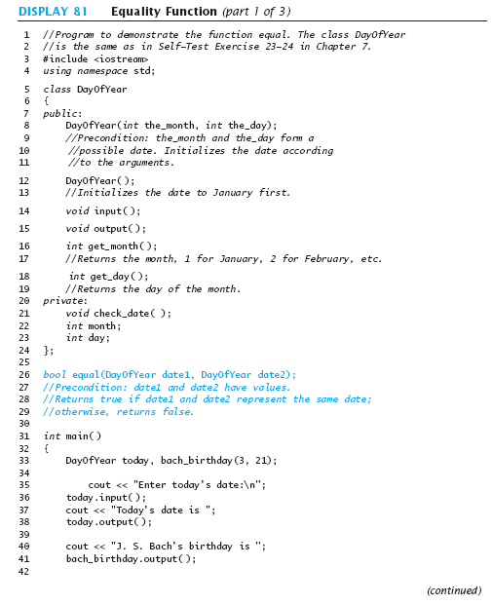
Display 11.1 (1/3)
Back
Next

Slide 112
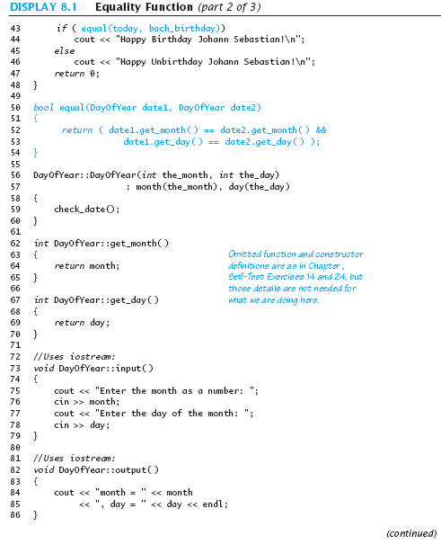
Display 11.1 (2/3)
Back
Next

Slide 113
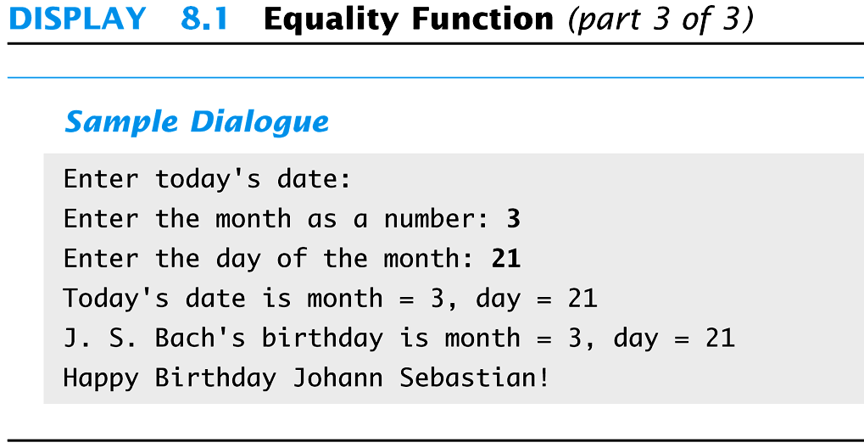
Display 8.1 (3/3)
Back
Next

Slide 114
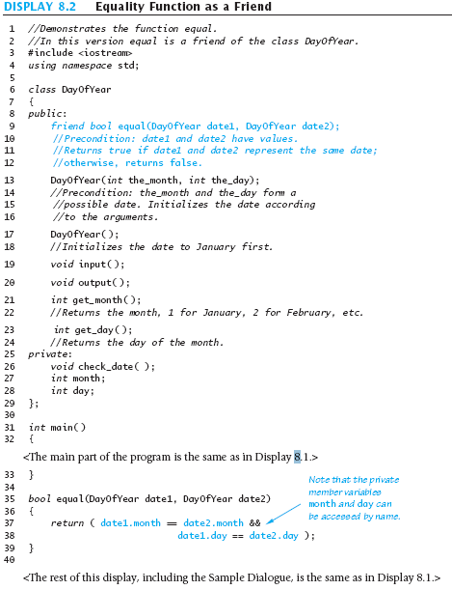
Display 8.2
Back
Next

Slide 115
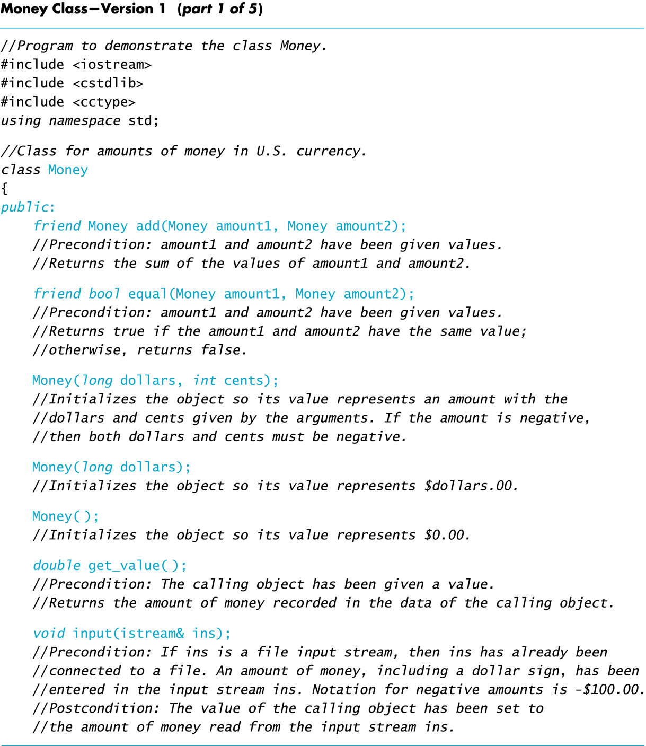
Display 8.3 (1/5)
Back
Next

Slide 116
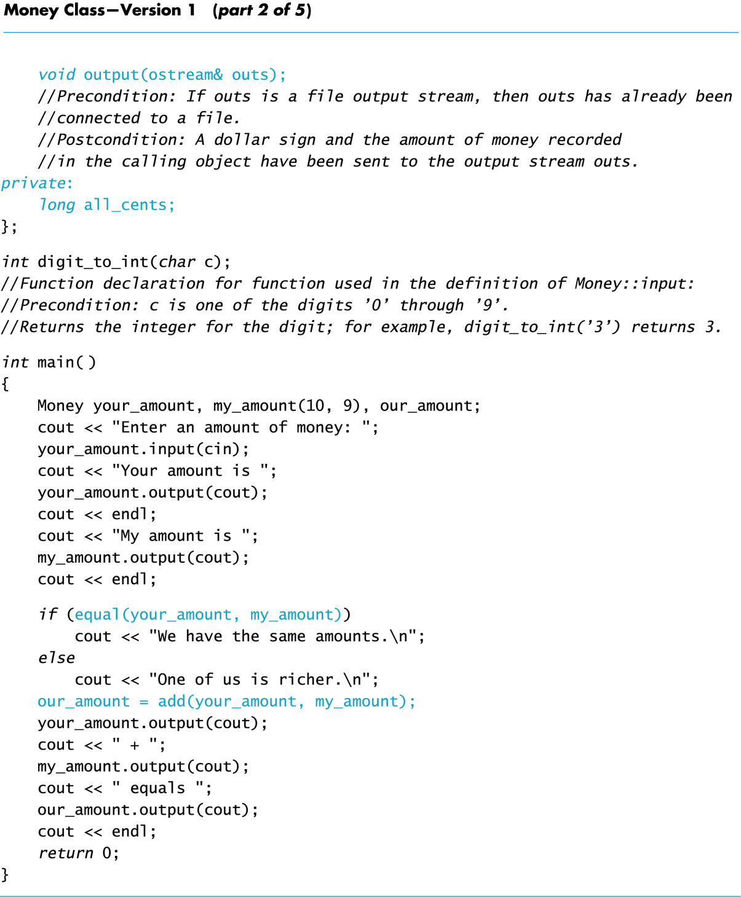
Display 8.3 (2/5)
Back
Next

Slide 117
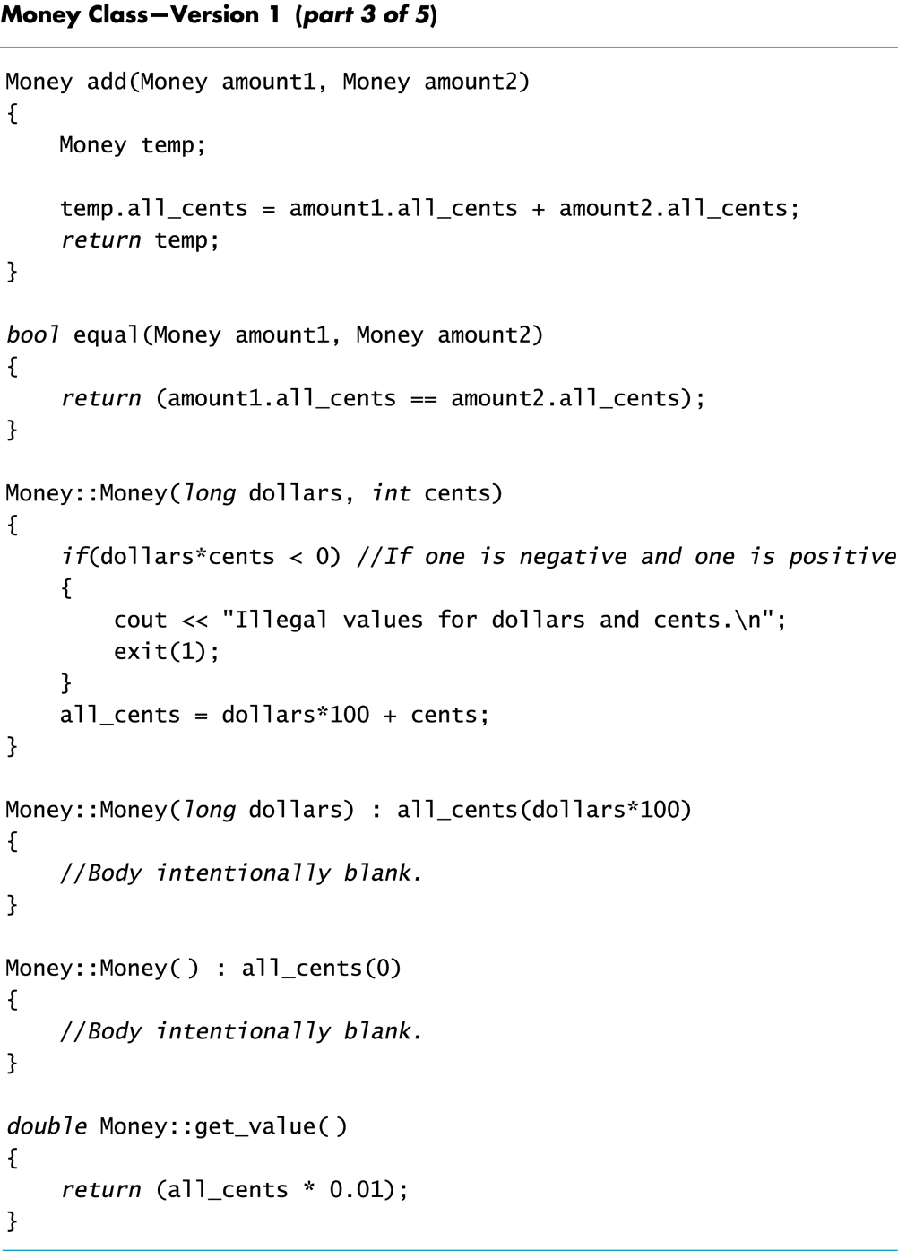
Display 8.3 (3/5)
Back
Next

Slide 118
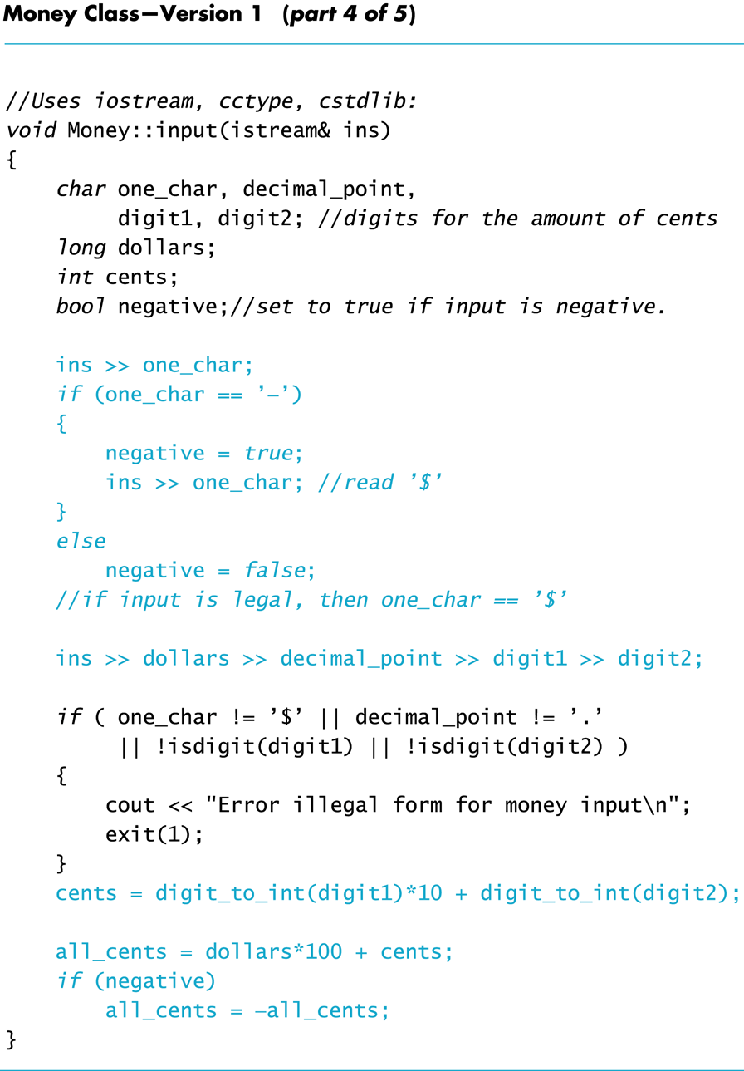
Display 8.3 (4/5)
Back
Next

Slide 119
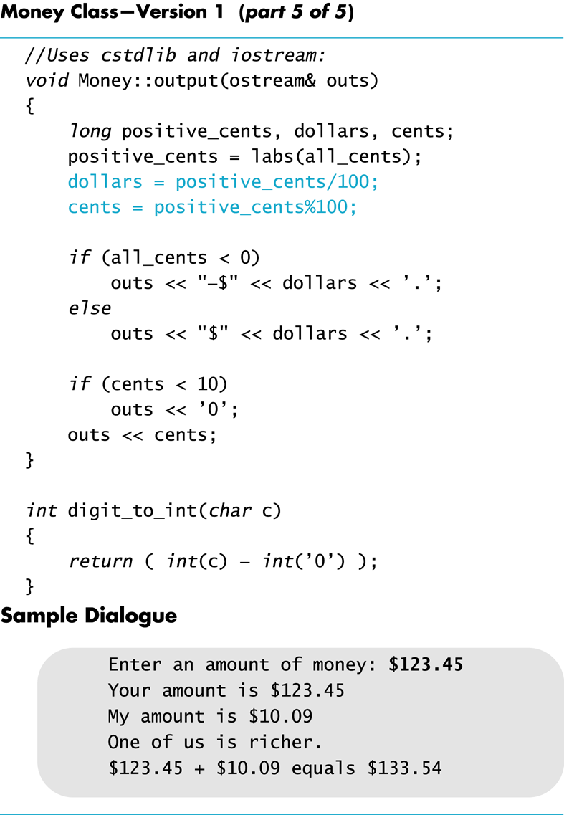
Display 8.3 (5/5)
Back
Next

Slide 120
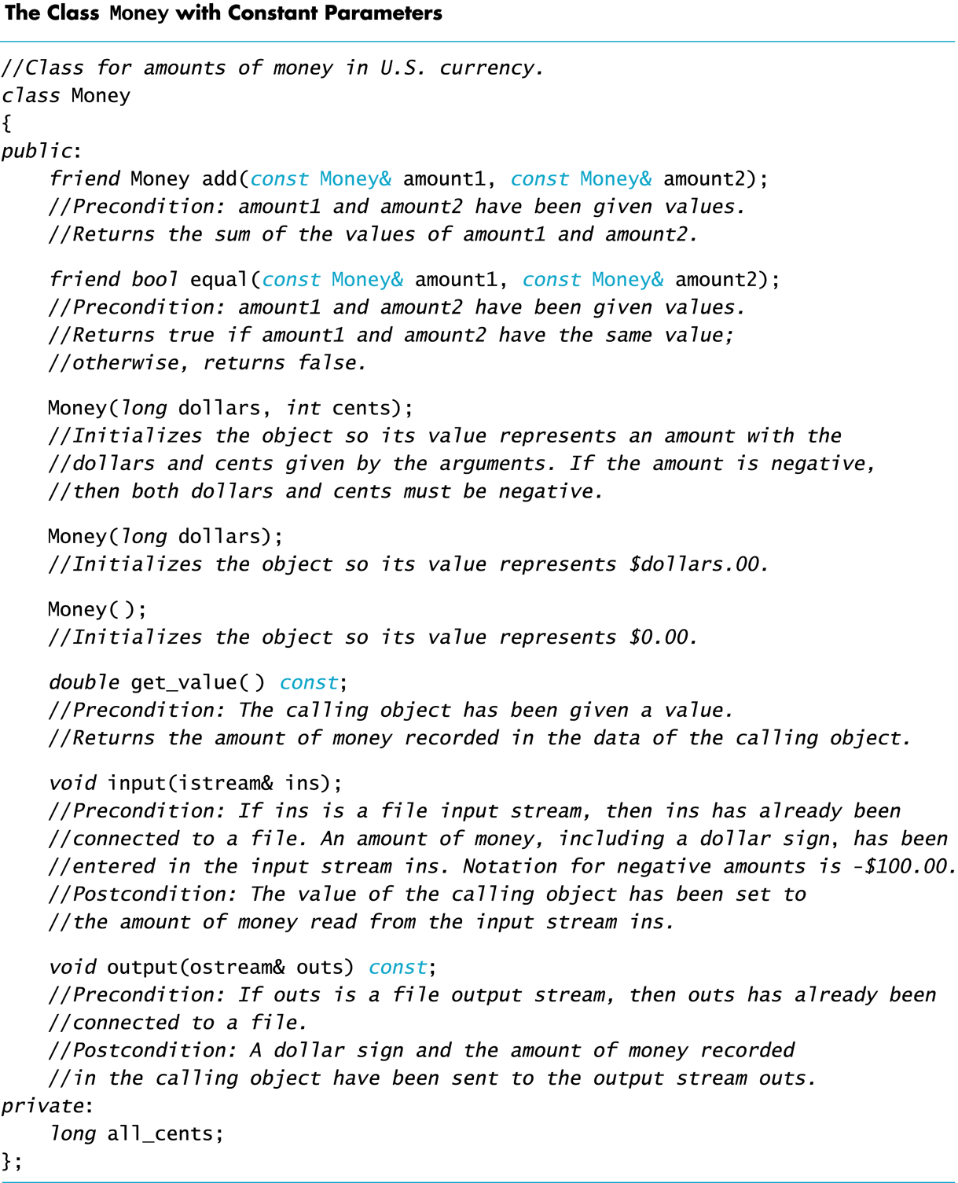
Display 8.4
Back
Next

Slide 121
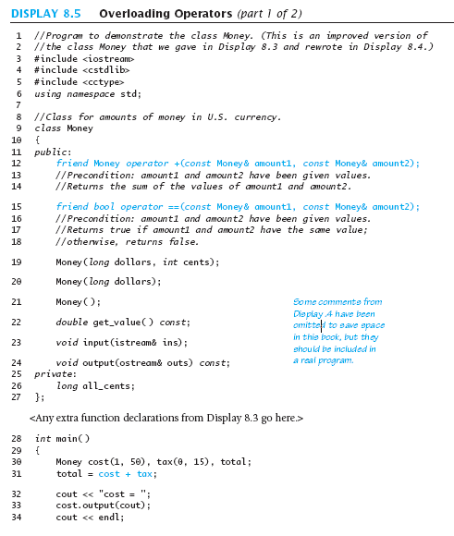
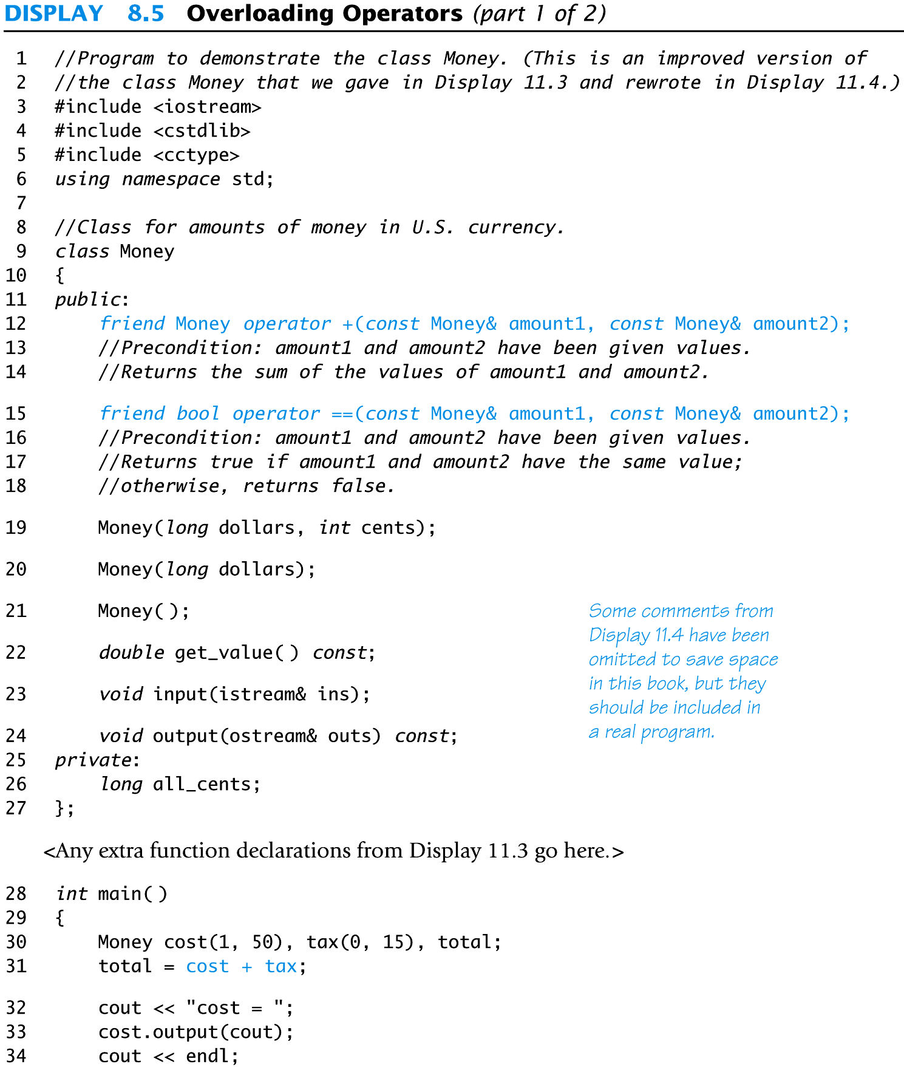
Display 8.5 (1/2)
Back
Next

Slide 122
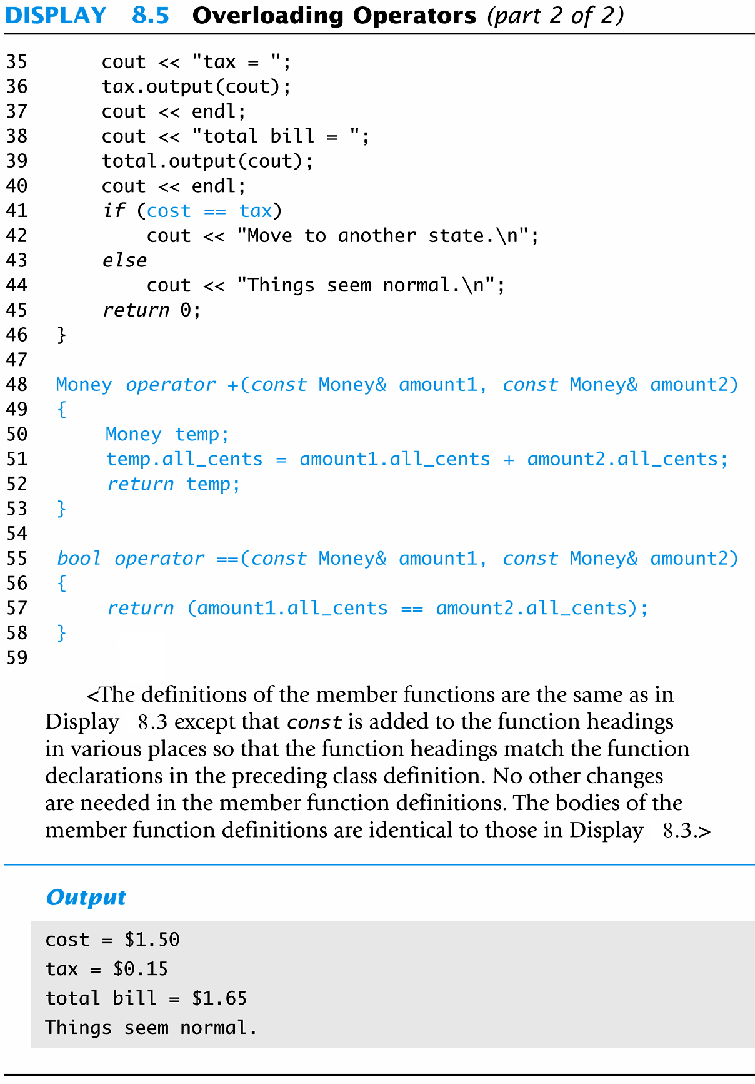
Display 8.5 (2/2)
Back
Next

Slide 123
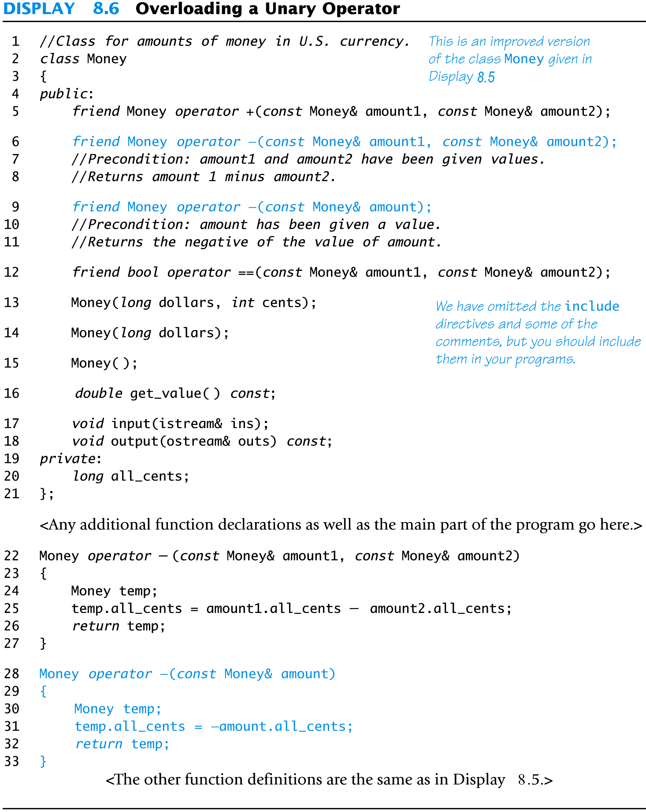
Display 8.6
Back
Next

Slide 124
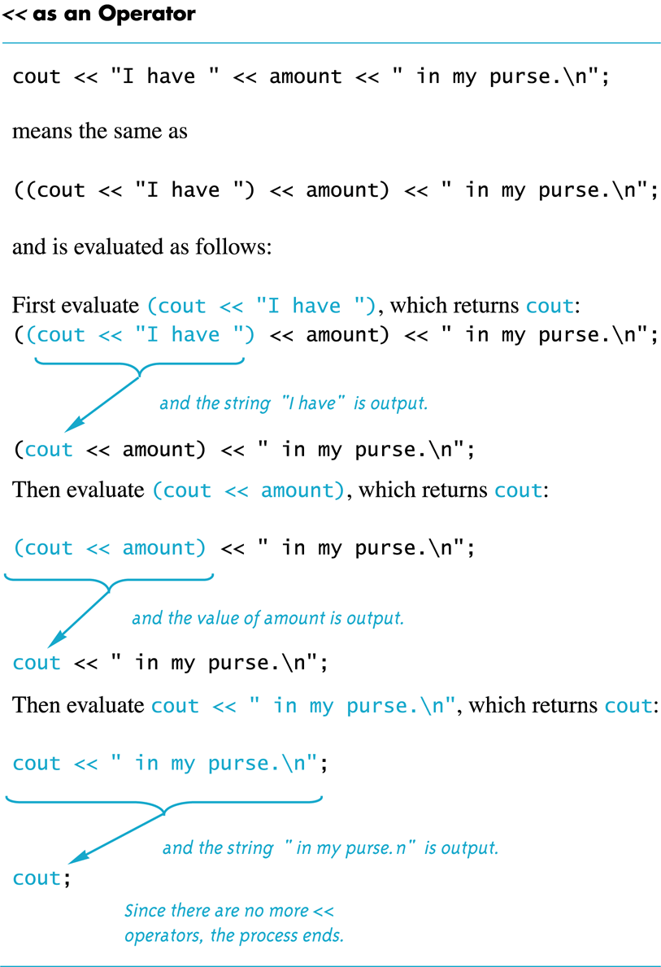
Display 8.7
Back
Next

Slide 125
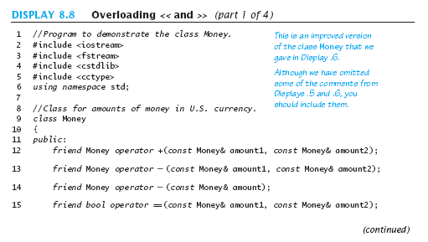
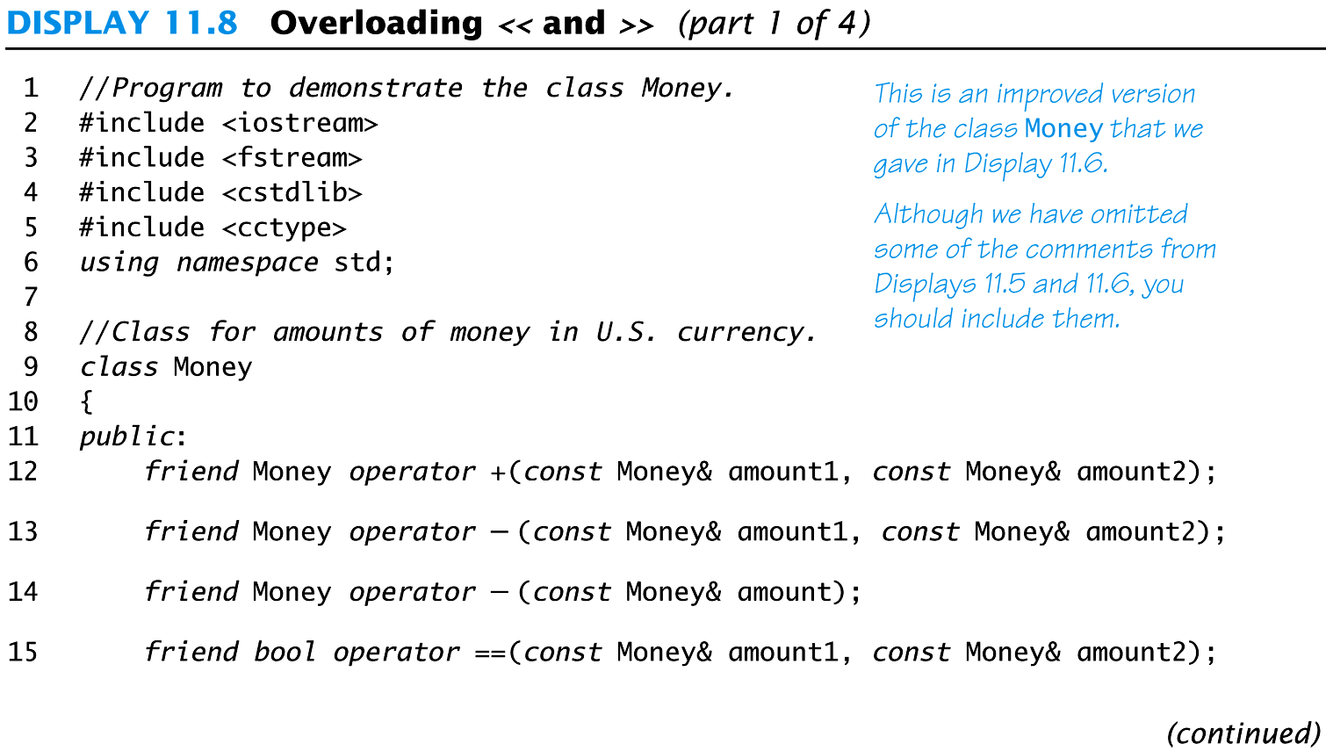
Display 8.8 (1/4)
Back
Next

Slide 126
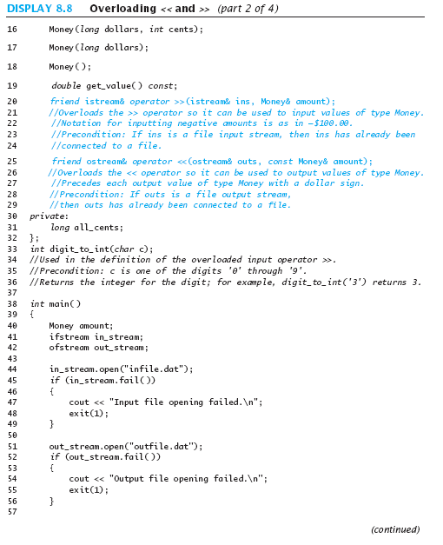
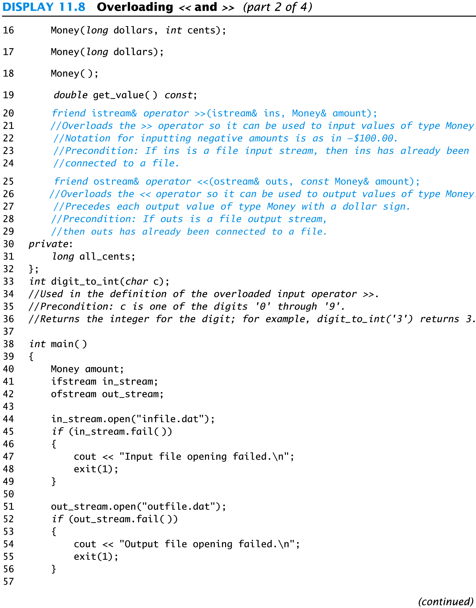
Display 8.8(2/4)
Back
Next

Slide 127
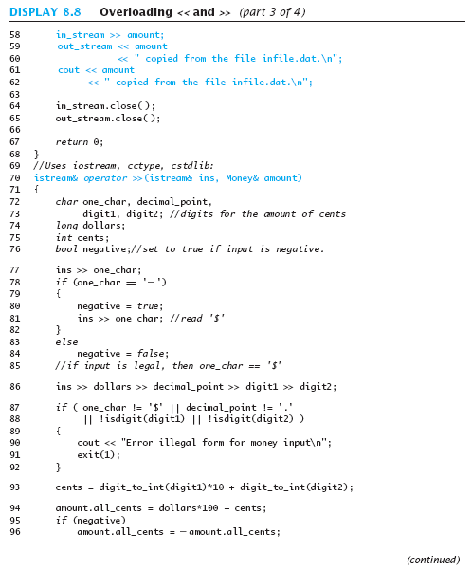
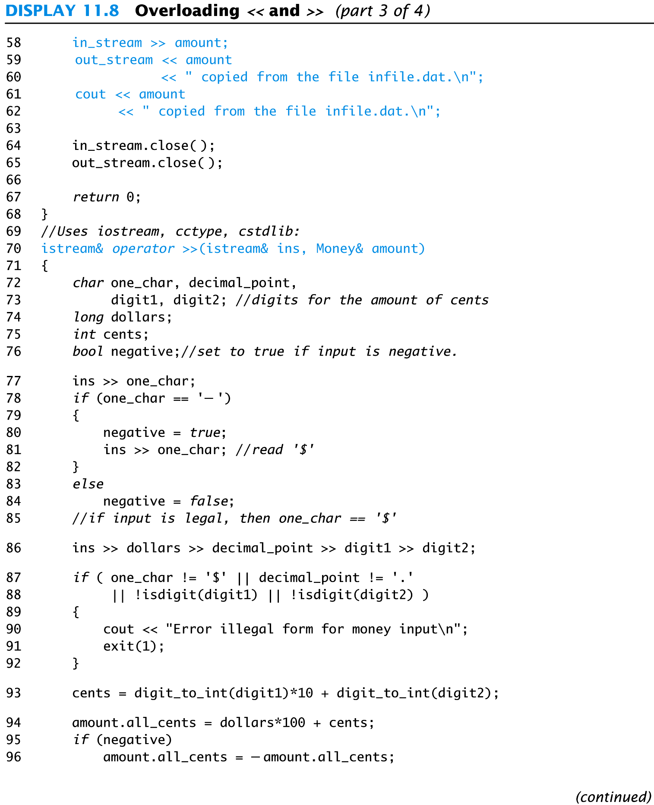
Display 8.8 (3/4)
Back
Next

Slide 128
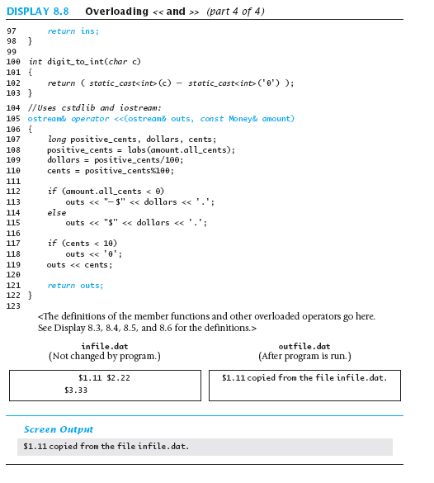
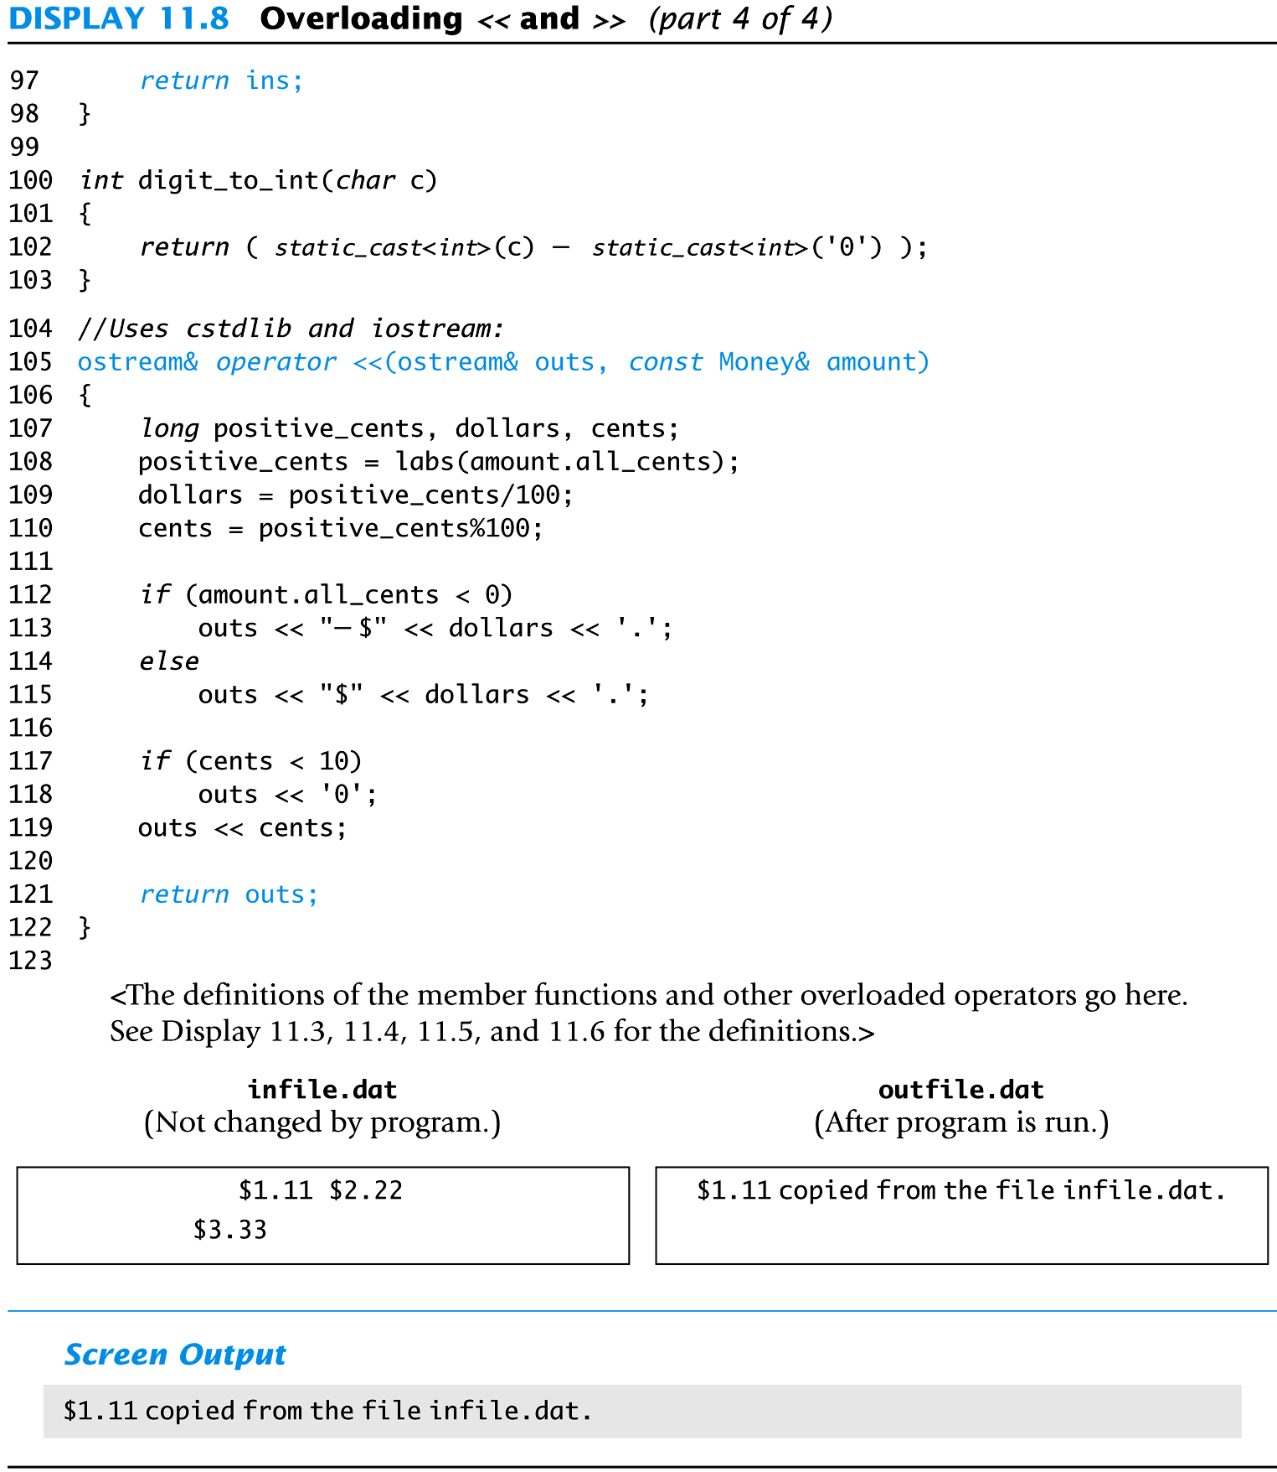
Display 8.8 (4/4)
Back
Next

Slide 129
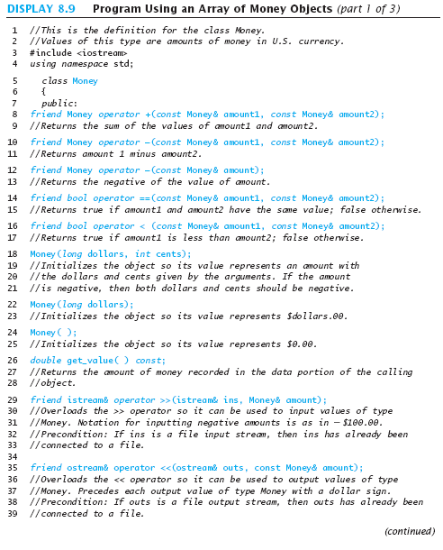
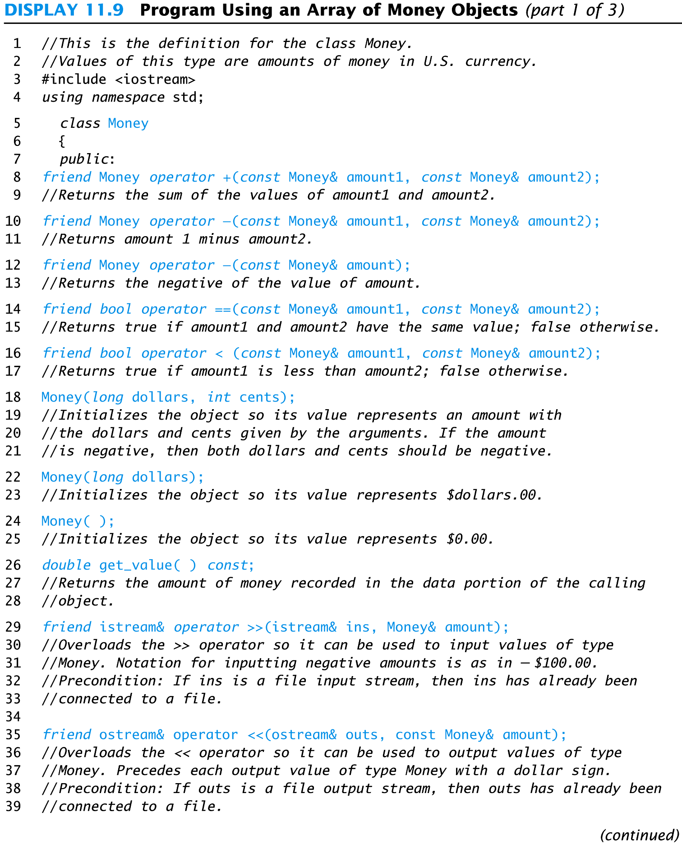
Display 8.9 (1/3)
Back
Next

Slide 130
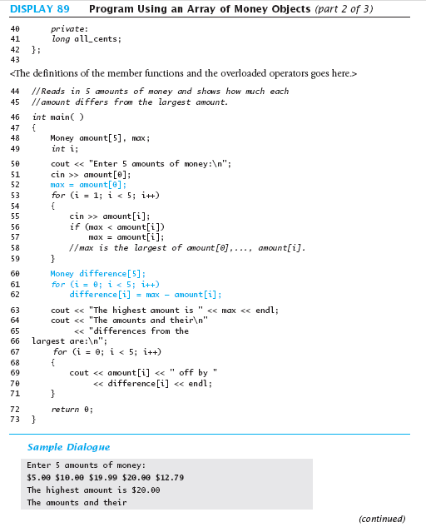
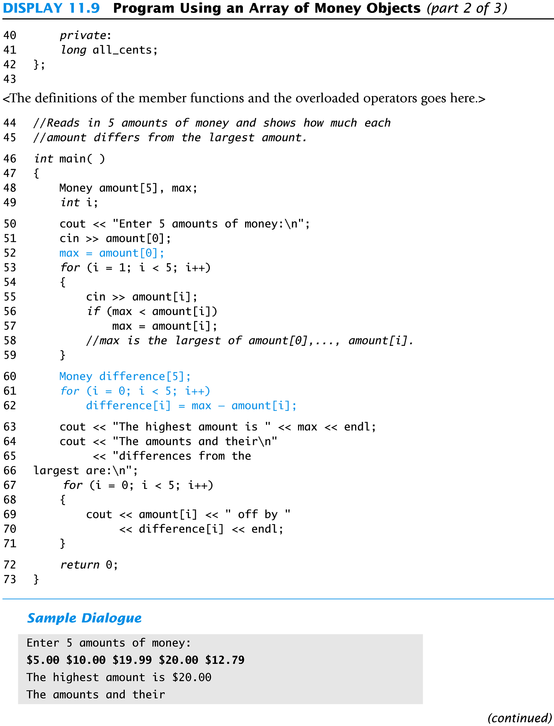
Display 8.9 (2/3)
Back
Next

Slide 131
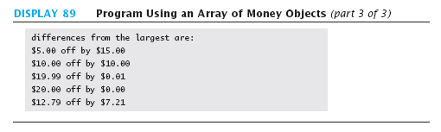
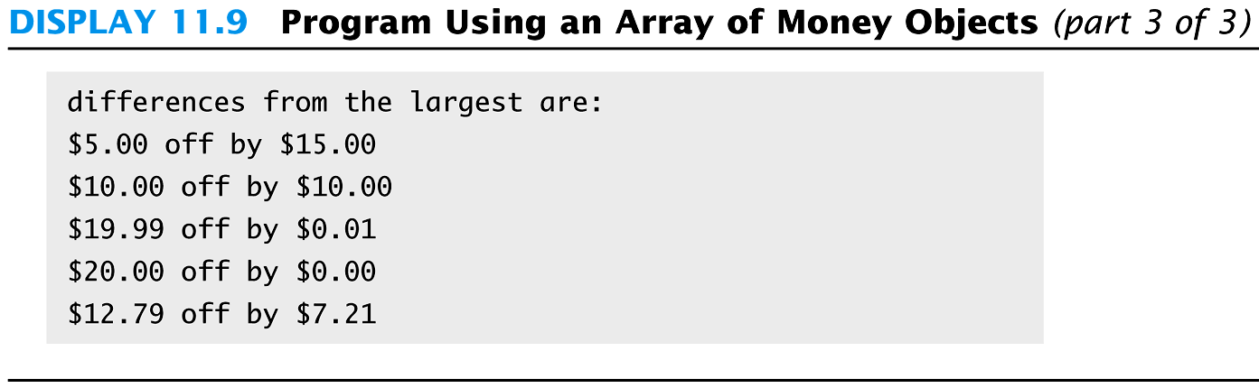
Display 8.9 (3/3)
Back
Next

Slide 132
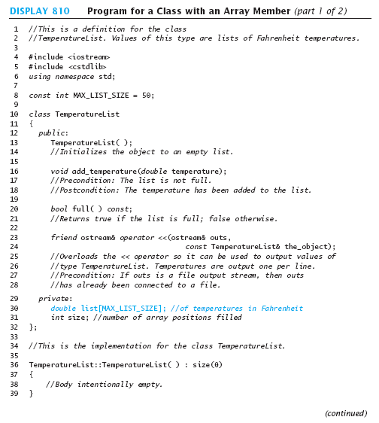
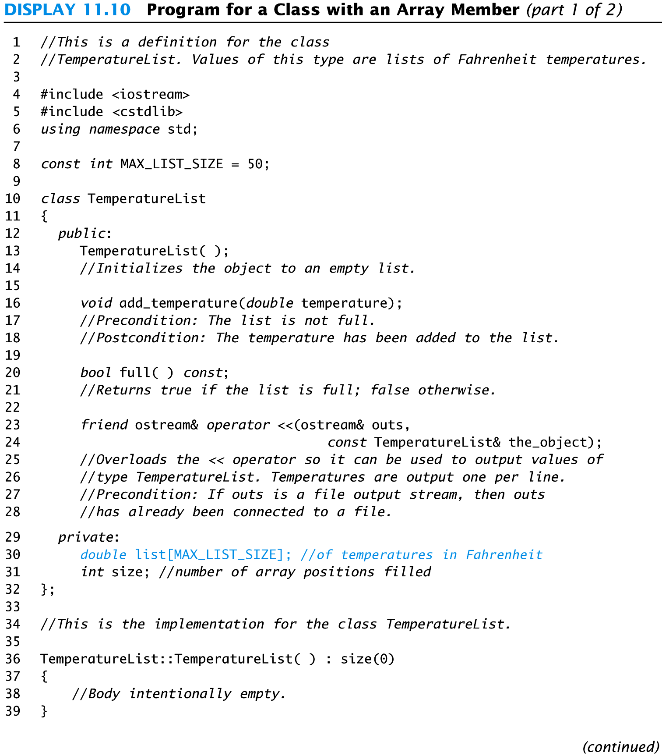
Display 8.10 (1/2)
Back
Next

Slide 133
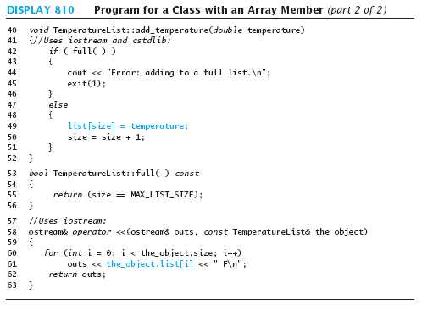
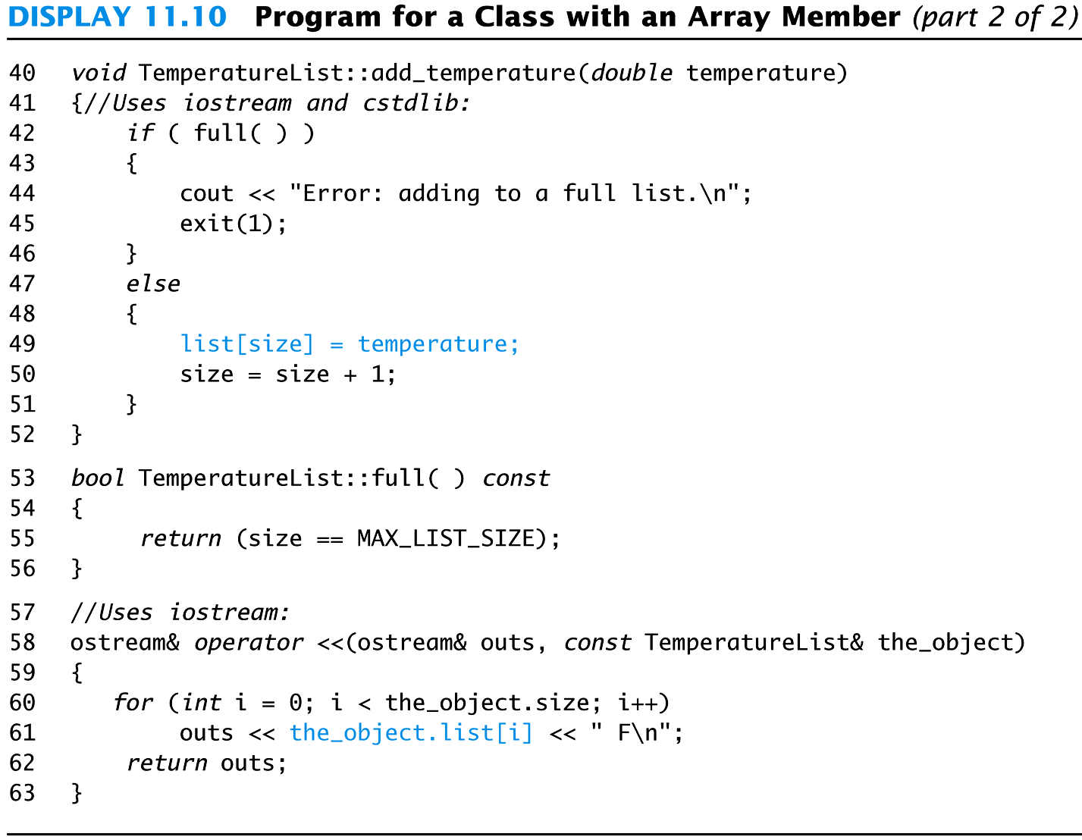
Display 8.10 (2/2)
Back
Next

Slide 134
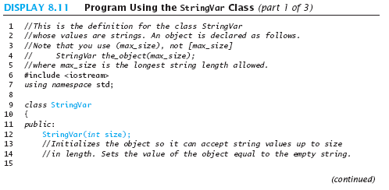
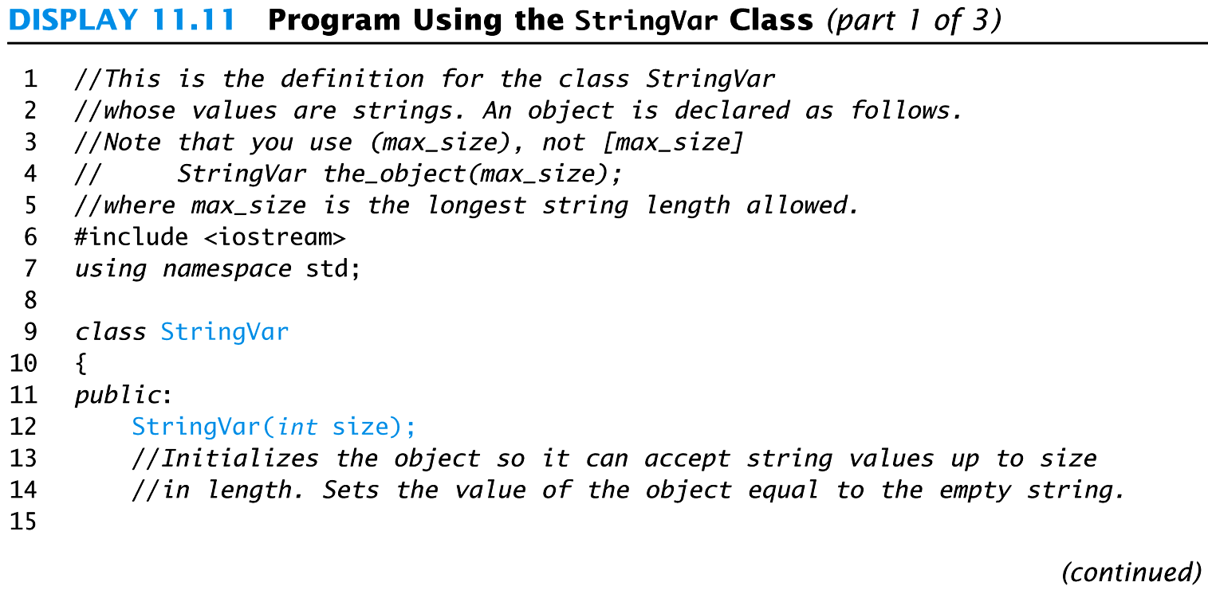
Display 8.11 (1/3)
Back
Next

Slide 135
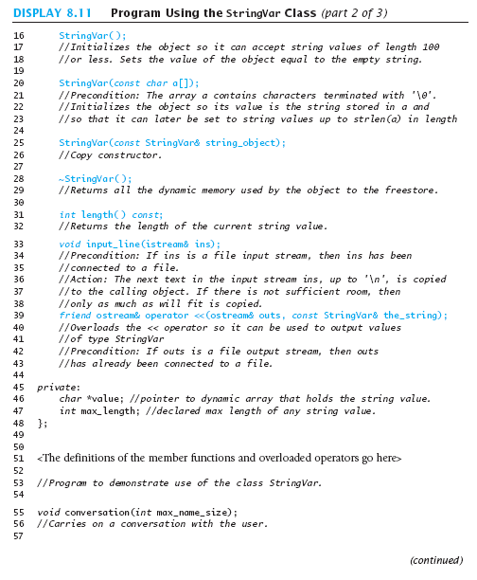
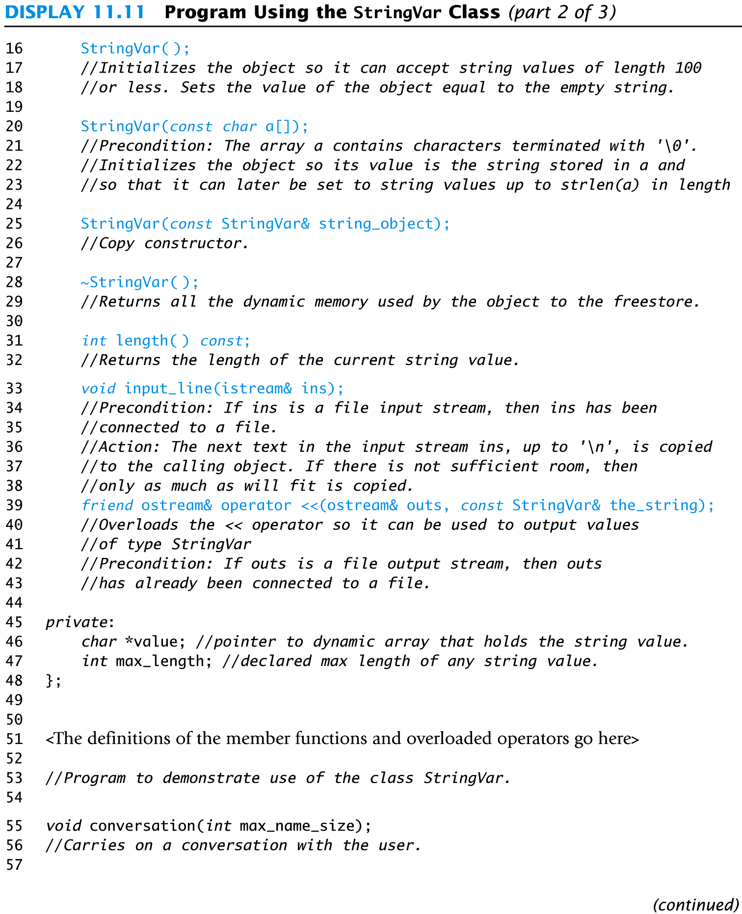
Display 8.11 (2/3)
Back
Next

Slide 136
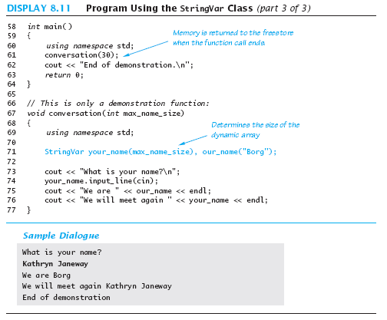
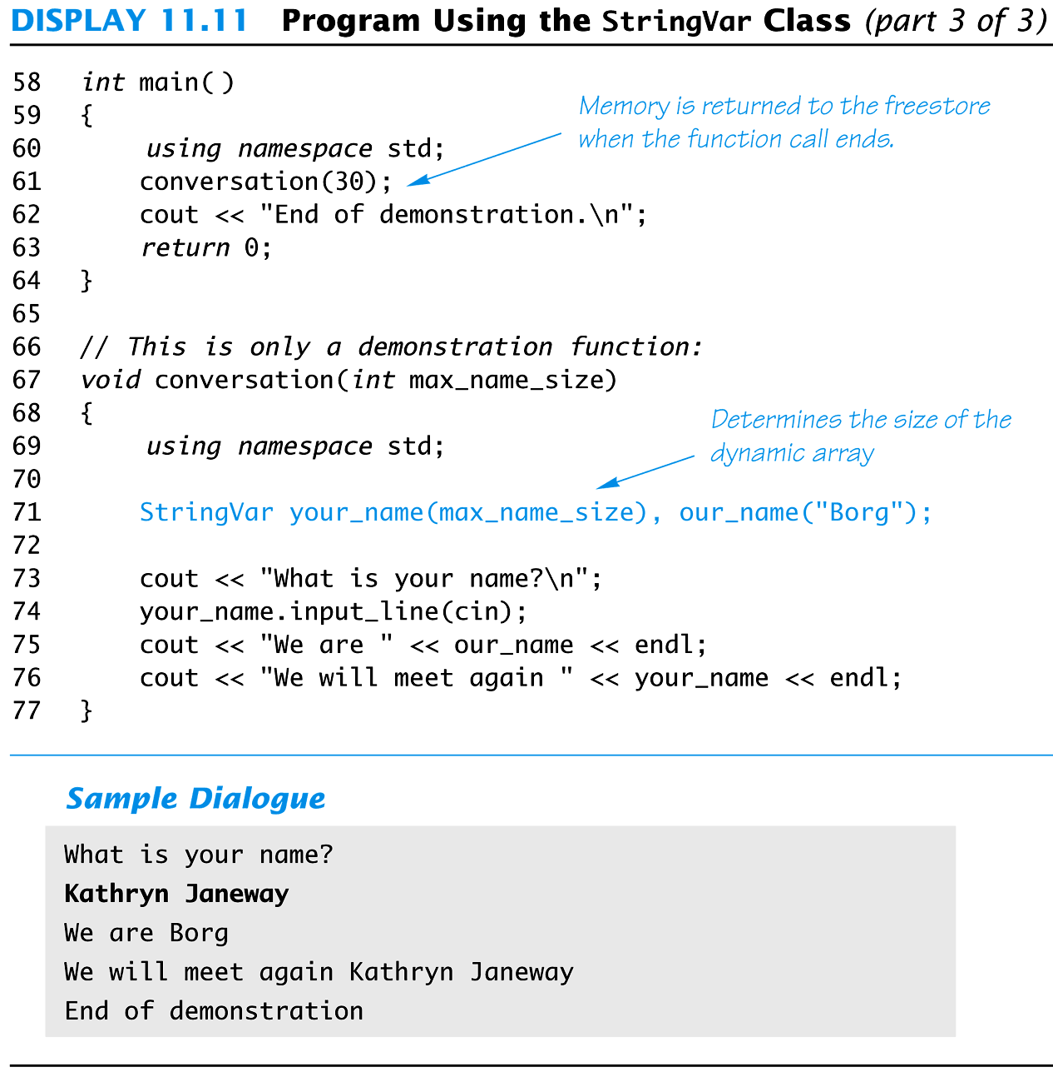
Display 8.11 (3/3)
Back
Next

Slide 137
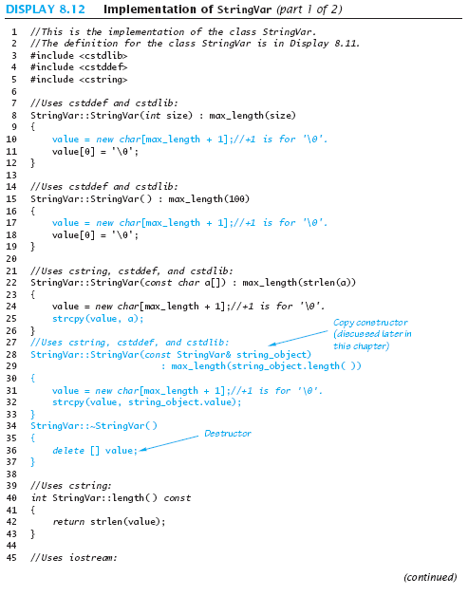
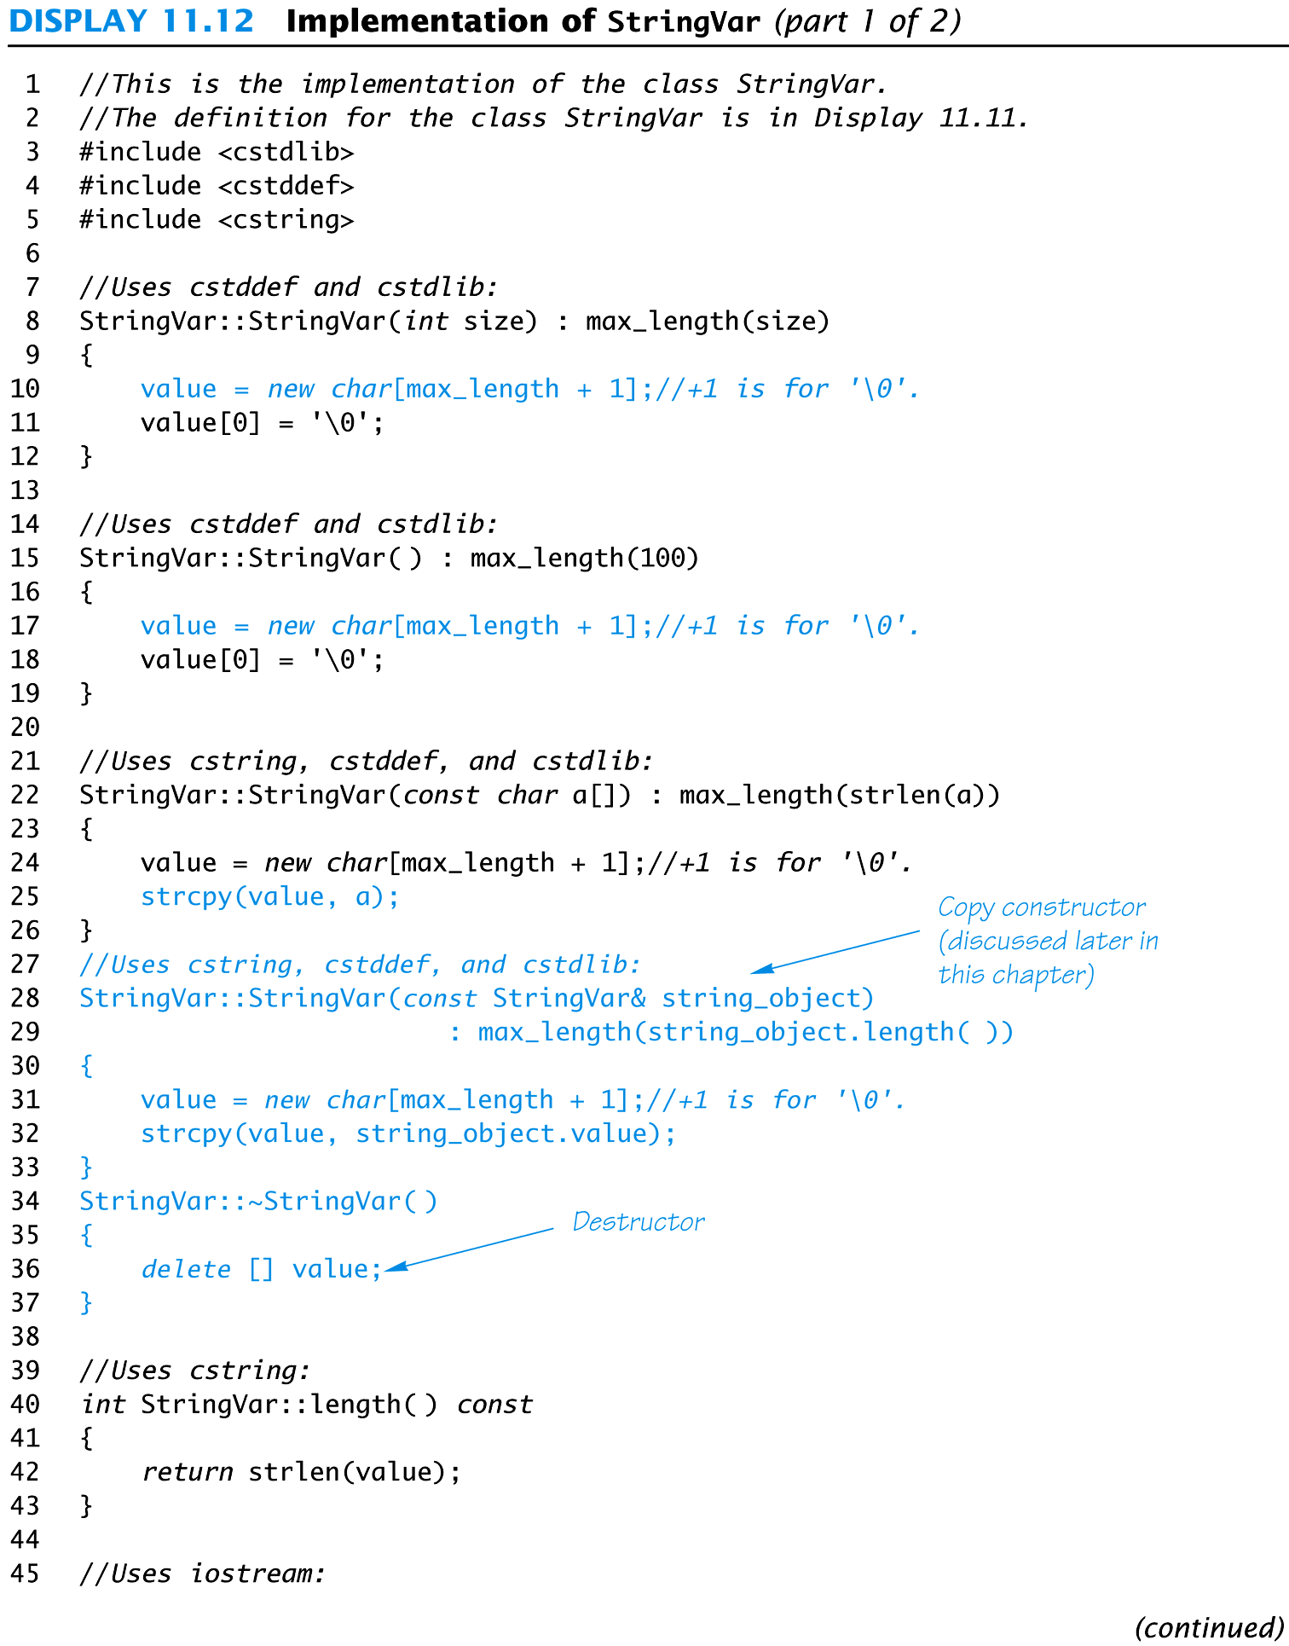
Display 8.12 (1/2)
Back
Next

Slide 138
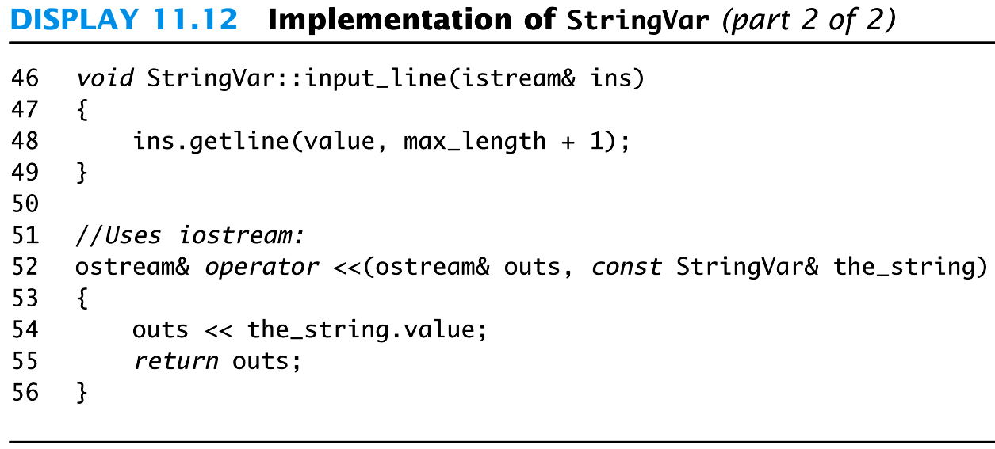
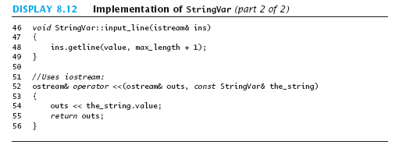
Display 8.12 (2/2)
Back
Next

Slide 139
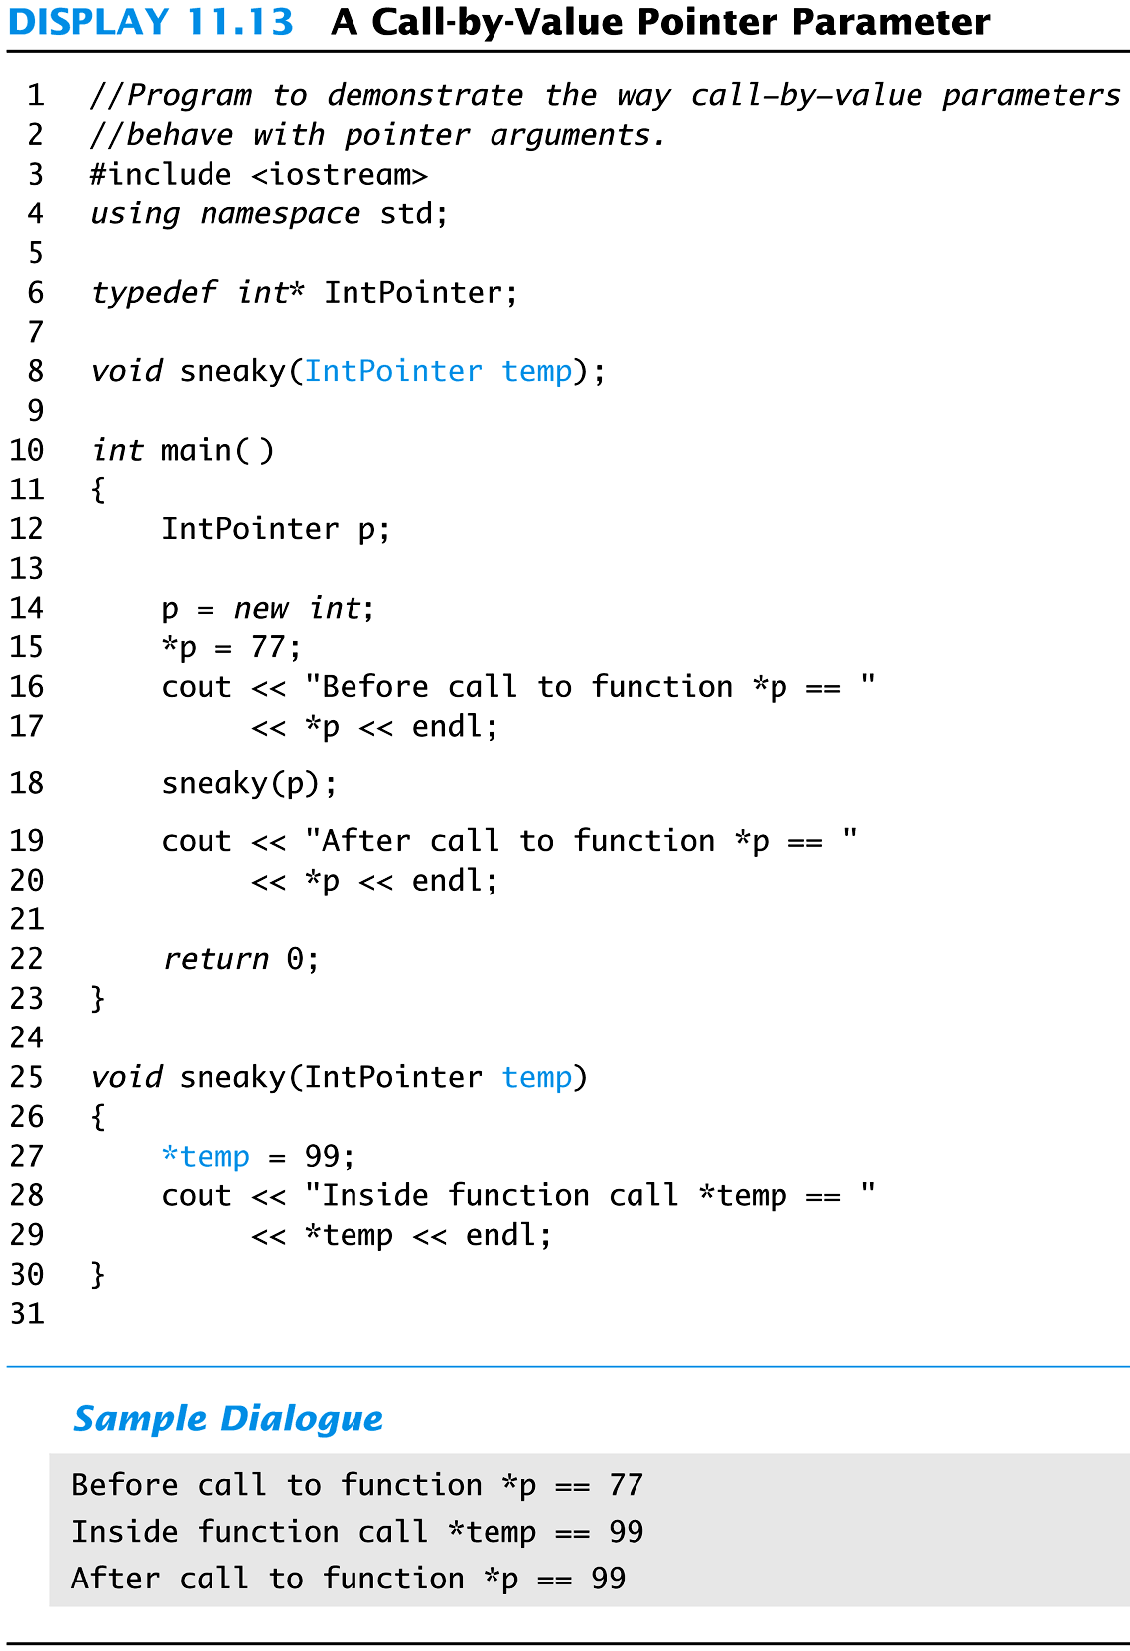
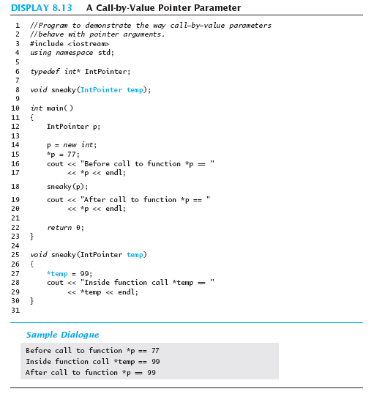
Display 8.13
Back
Next

Slide 140
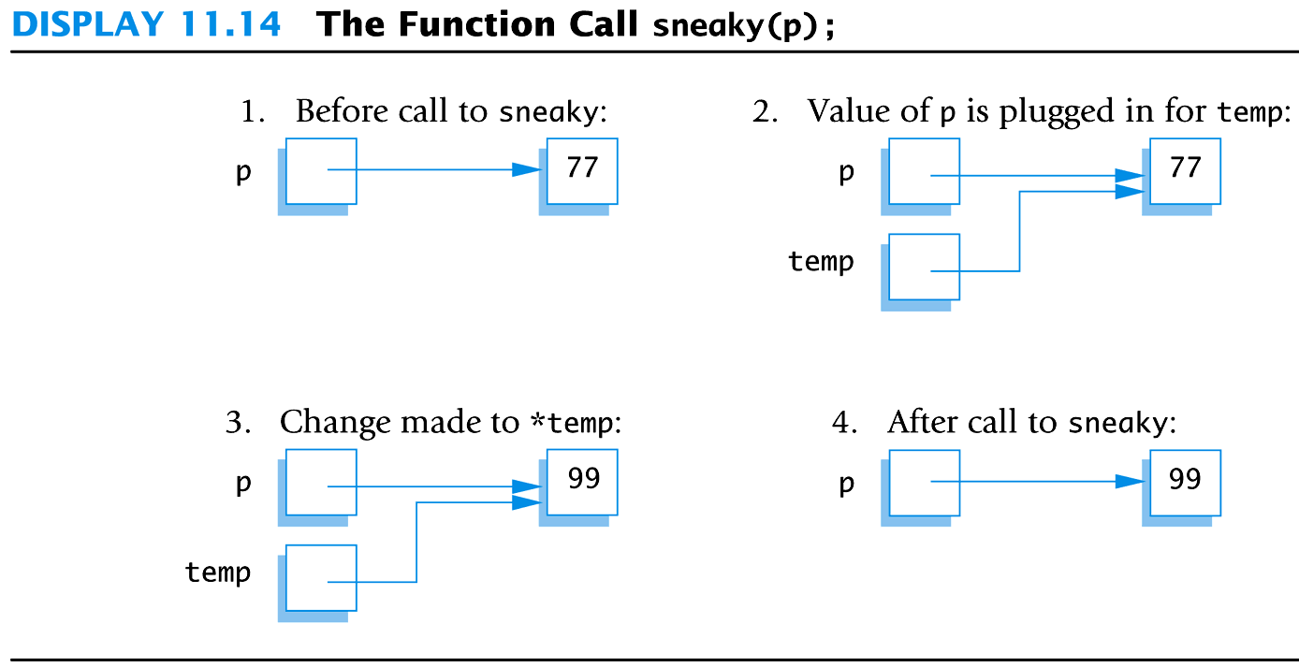
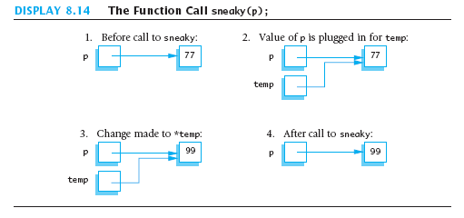
Display 8.14
Back
Next

